Slide 1

Reconocimiento de Patrones
Domingo Mery
Departamento de Ciencia de la Computación
Escuela de Ingeniería
Universidad Católica de Chile
Carácterísticas de Contraste
[ Capítulo 2 ]

Slide 2
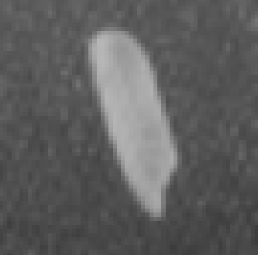
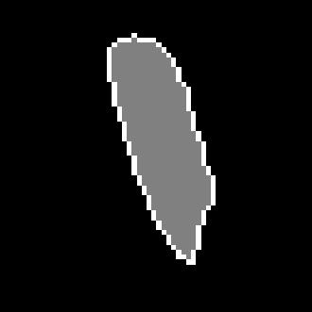
a) Grayscale image b) Segmentation c) 3D representation of a)
There are two categories of features: Geometric Features and
Intensity Features
Geometric Features give information about location, orientation, shape and size.
Intensity Features give information about how are the grayvalues.

Slide 3
Intensity Features

Slide 4
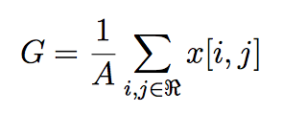
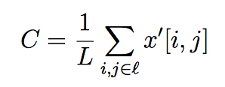
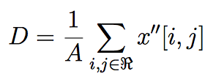
x
x
i
j
Average
Mean gradient
Mean 2nd gradient
Standard deviation, etc.

Slide 5
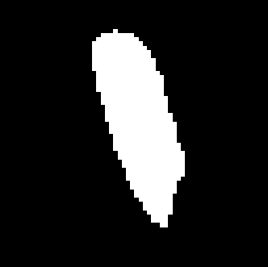

Contrast Features
x
e
x
i
j
e

Slide 6
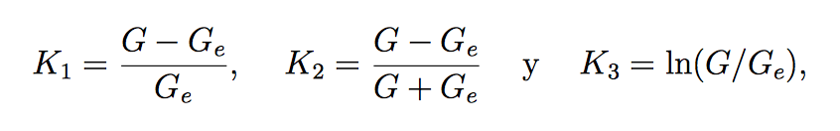
Contrast Features
x
e
x
i
j
Contrast
e
e
e

Slide 7
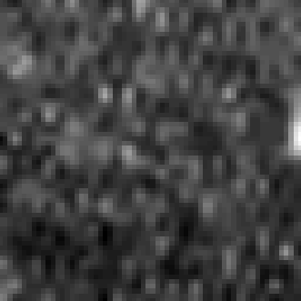


Contrast Features
I R Re
I = imread('onerice.bmp');
R = I>120;
J = imdilate(R,ones(11,11));
Re = and(not(R),J);
i = find(R==1);
ie = find(Re==1);
G = mean(I(i));
Ge = mean(I(ie));
K1 = abs(G-Ge)/Ge % 0.85 0.0051
K2 = abs(G-Ge)/(G+Ge) % 0.30 0.0025
K3 = log(G/Ge) % 0.62 0.0051

Slide 8
Reconocimiento de Patrones
Domingo Mery
Departamento de Ciencia de la Computación
Escuela de Ingeniería
Universidad Católica de Chile
Crossing Line Profiles
[ Capítulo 2 ]

Slide 9
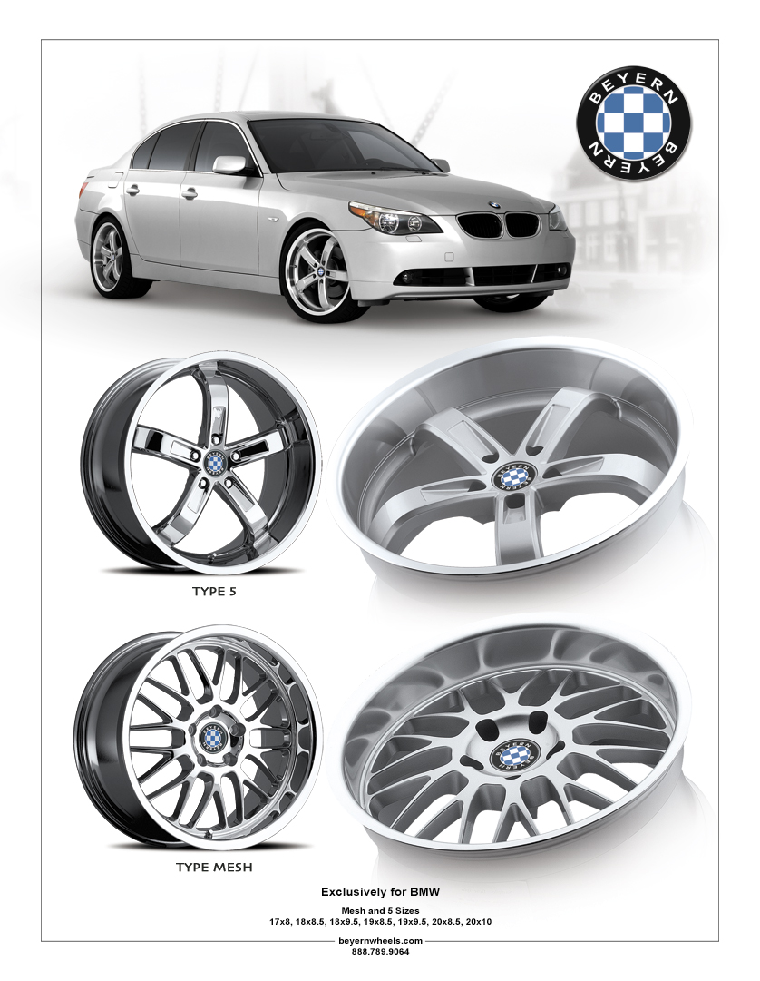

Slide 10
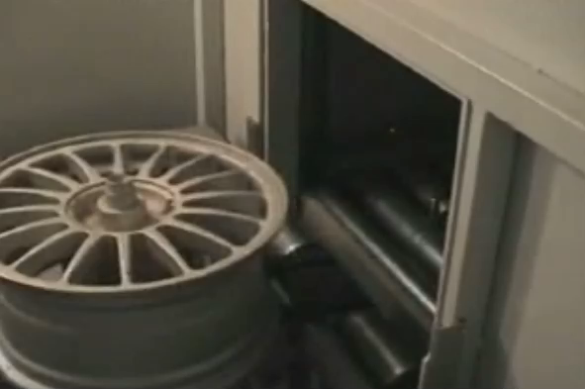
X-ray testing: Castings

Slide 11
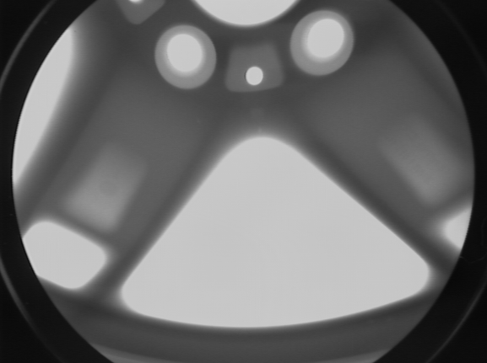
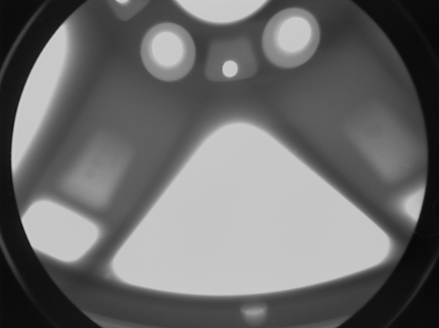
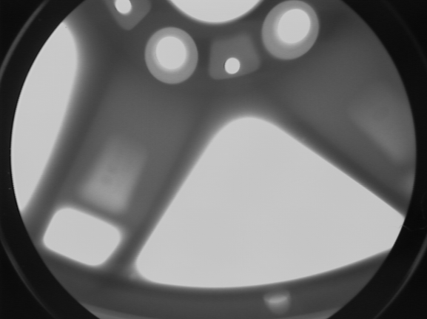
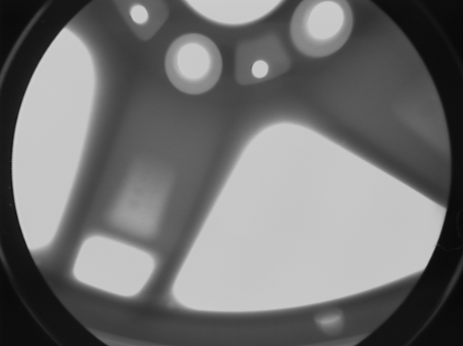
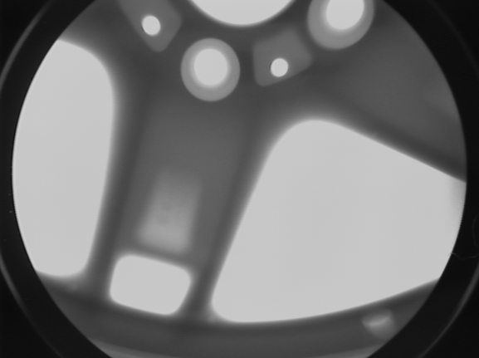
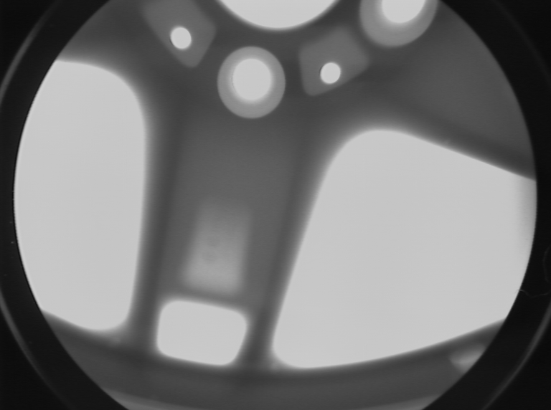
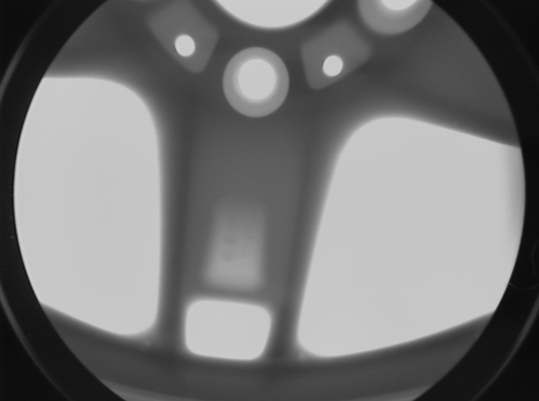
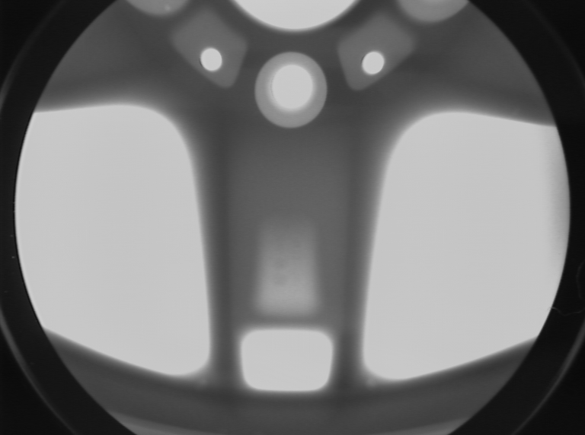
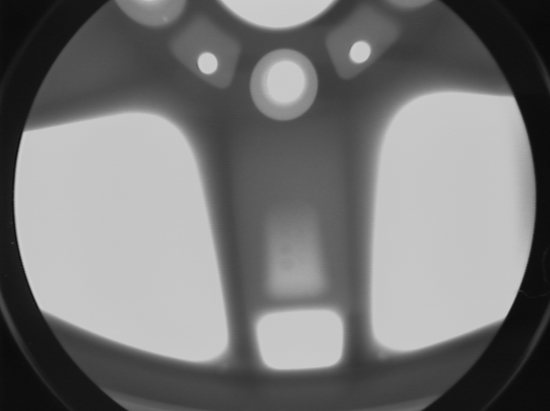
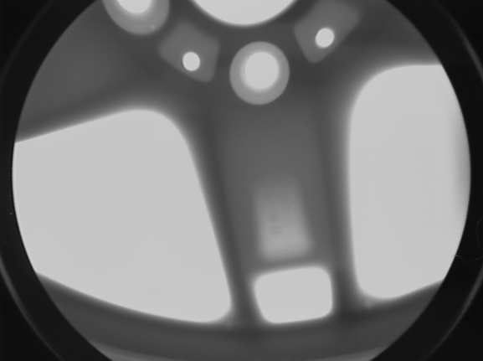
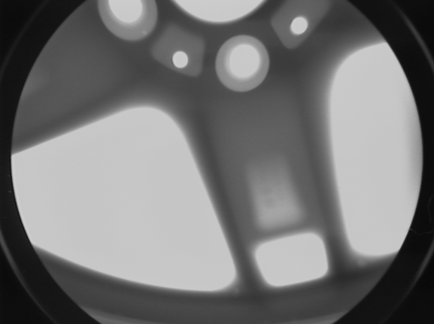
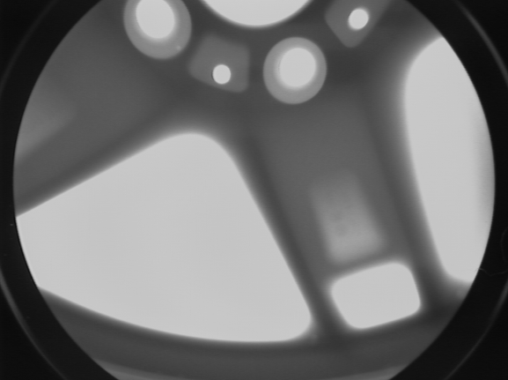
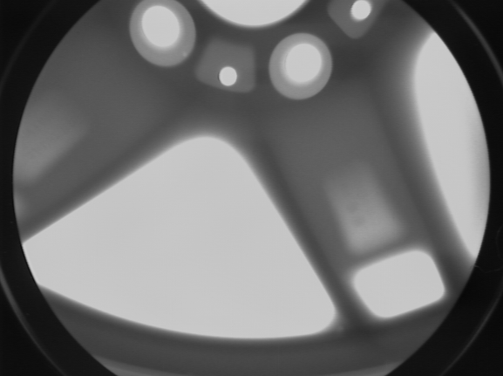
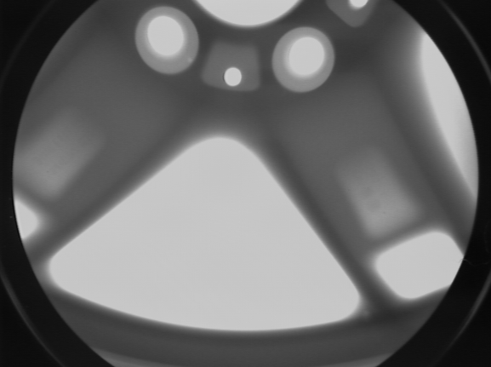
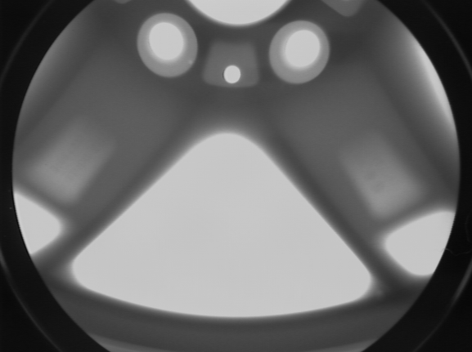
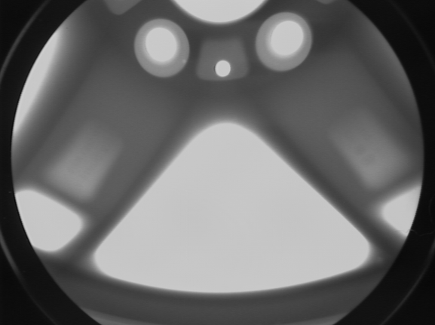
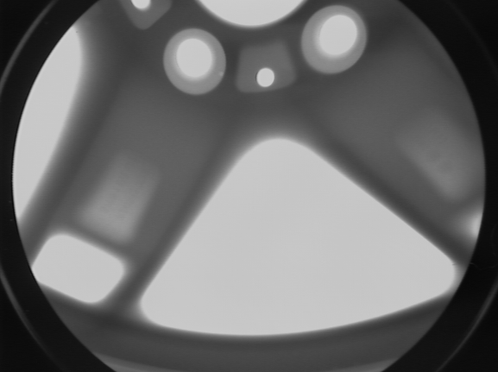
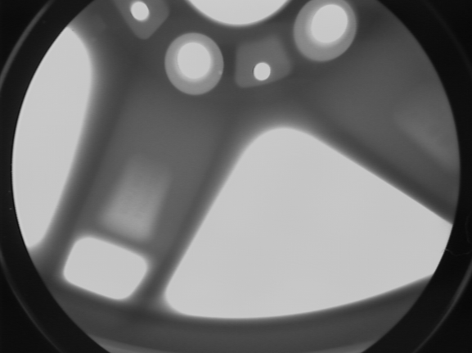
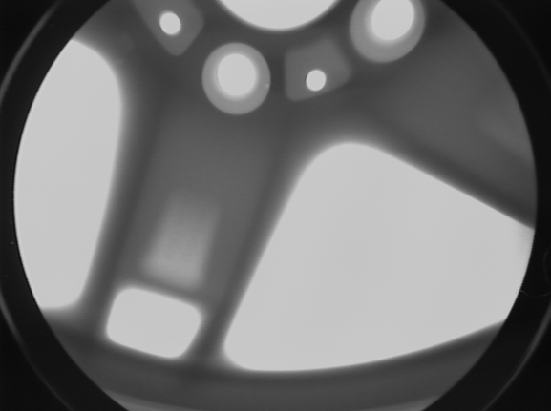
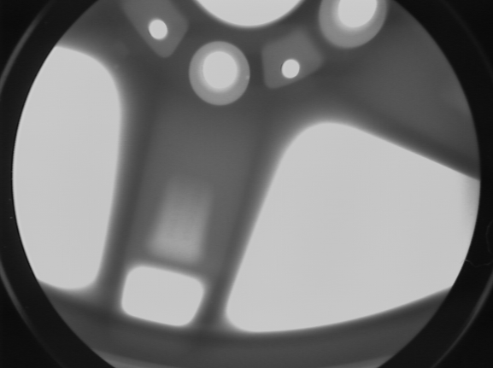
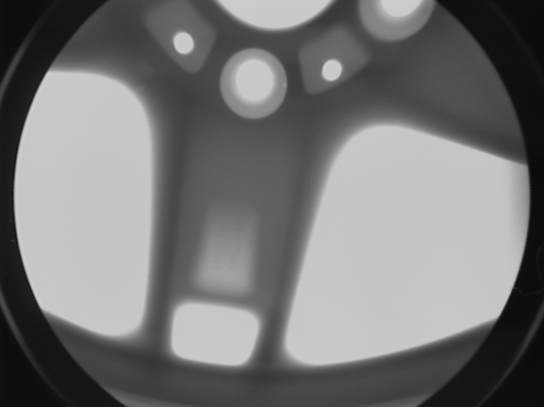
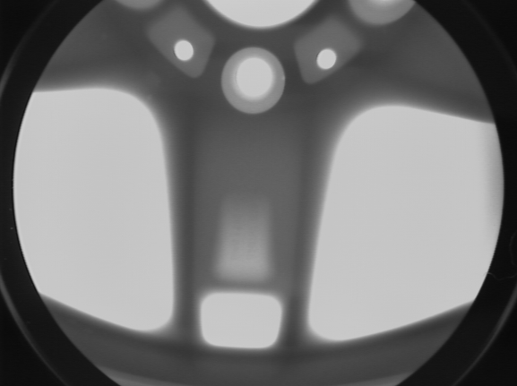



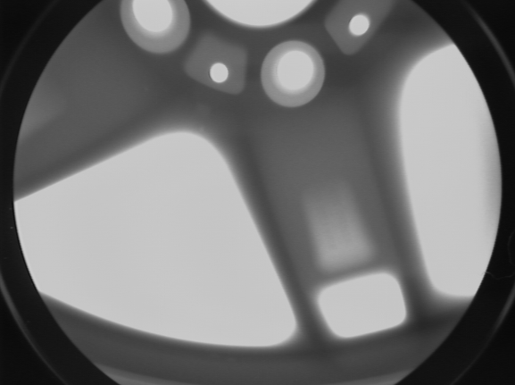

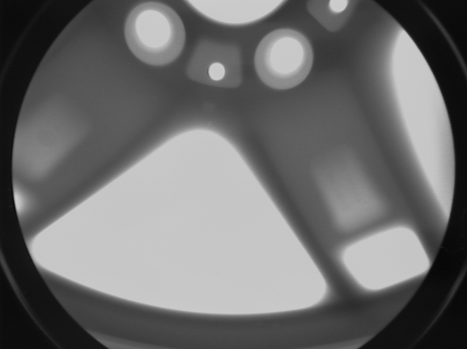
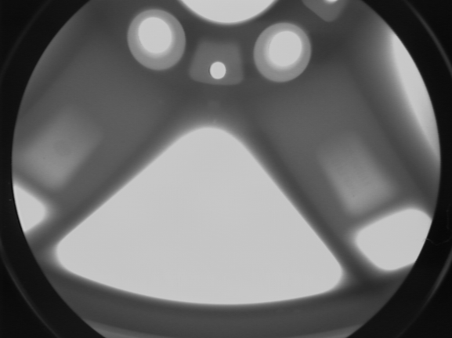
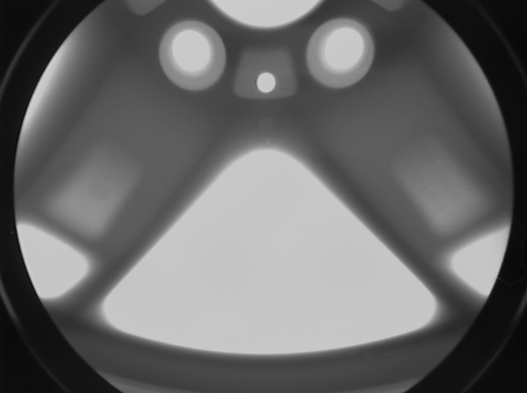
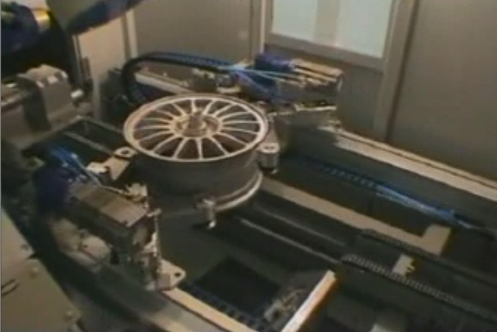
X-ray testing: Castings

Slide 12

X-ray testing: Castings

Slide 13
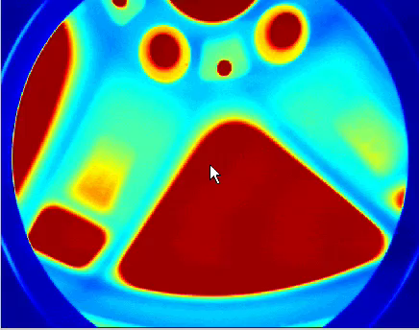
X-ray testing: Castings

Slide 14
X-ray testing: Castings

Slide 15
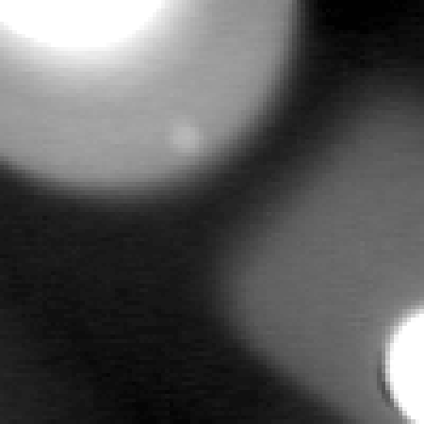

[ Crossing line profiles ]
Early work
D.Mery: Crossing Line Profile 15
Präsentation

Slide 16
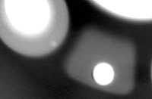
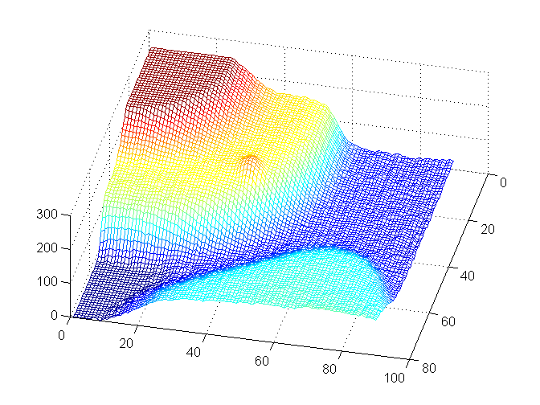
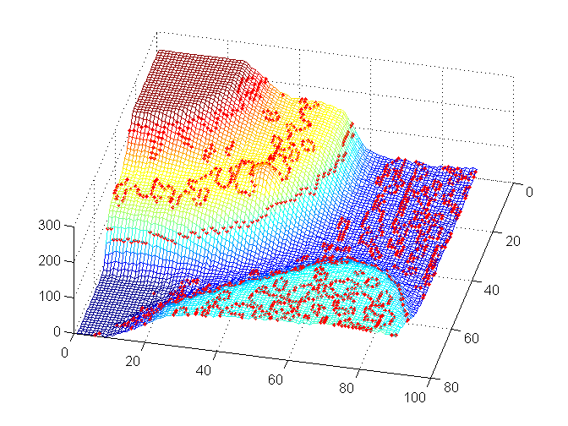
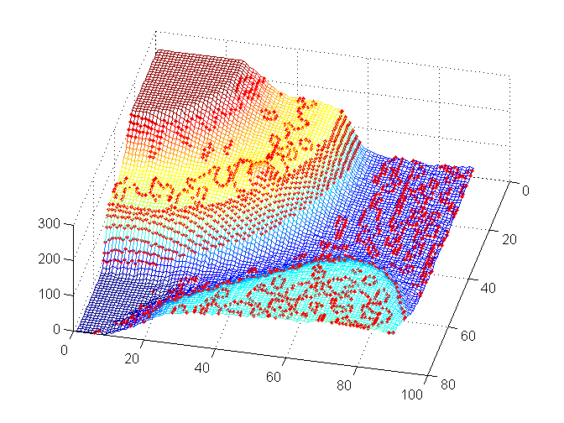
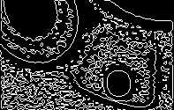
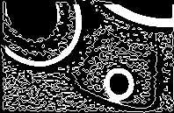
[ Segmentation of potential flaws ]
X-ray image in 3D
Edge detection with LoG
Edge detection with LoG + gradient
D.Mery: Crossing Line Profile 16
Präsentation

Slide 17
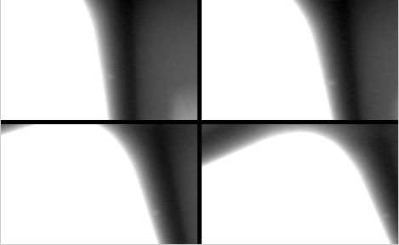
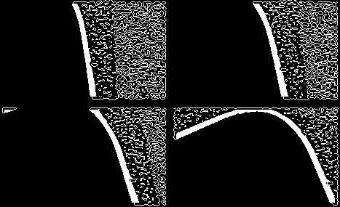
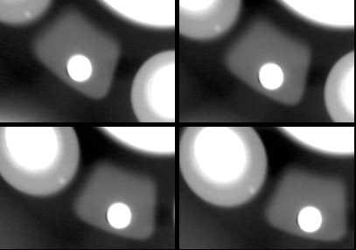
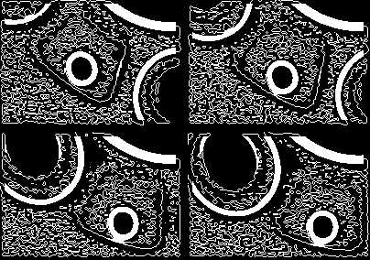
[ Segmentation of potential flaws ]
22.936 regions were segmented in 50 X-ray images
60 were real defects
22.876 were false alarms
[ ratio = 381:1 ]
D.Mery: Crossing Line Profile 17
Präsentation

Slide 18
[ Crossing line profiles ]
Early work
250
P
250
Q
200
200
150
150
250
K
Y
100
100
200
50
50
150
0
0
100
10
20
30
10
20
30
50
250
P
250
Q
0
10
20
30
40
50
60
200
200
Extracted features:
σ_{K}
Δ _{K}
150
150
Y
100
100
50
50
0
10
20
30
0
10
20
30
D.Mery: Crossing Line Profile 18
Präsentation

Slide 19
[ Crossing line profiles ]
Proposed approach
250
k=0
250
k=1
250
k=2
250
k=3
200
200
200
200
150
d
150
150
150
d
d
d
100
100
100
100
50
50
50
50
0
10
20
30
0
10
20
30
0
10
20
30
0
10
20
30
k=4
k=5
k=6
k=7
250
250
250
250
200
200
200
200
150
d
150
150
d
150
d
100
100
d_{min}
100
100
50
50
50
50
0
10
20
30
0
10
20
30
0
10
20
30
0
10
20
30
D.Mery: Crossing Line Profile 19
Präsentation

Slide 20
[ Crossing line profiles ]
Proposed approach
250
k=0
250
k=1
250
k=2
250
k=3
200
200
200
200
150
d
150
150
150
d
d
d
100
100
100
100
50
50
50
50
0
10
20
30
0
10
20
30
0
10
20
30
0
10
20
30
k=4
k=5
k=6
k=7
250
250
250
250
200
200
200
200
150
d
150
150
d
150
d
100
100
d_{min}
100
100
50
50
50
50
0
10
20
30
0
10
20
30
0
10
20
30
0
10
20
30
D.Mery: Crossing Line Profile 20
Präsentation

Slide 21
[ Crossing line profiles ]
Proposed approach
Selected
Crossing
Line Profile
Extracted
features:
Q
σ_{Q}
Δ _{Q}
F = DFT(Q)
P
Q
250
250
200
200
150
Y
150
100
d_{min}
100
50
50
0
10
20
30
0
10
20
30
D.Mery: Crossing Line Profile 21
Präsentation

Slide 22
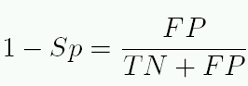

[ 4. Performance analysis ]
Class distribution
class ‘regular
structure’
Ideal:
FN = 0
FP = 0
Sn = 100%
1-Sp = 0%
Az = 1
class ‘defect’
TN
TP
(a)
x
FN
θ
FP
ROC curve
Confusion matrix
the region is
100 %
θ = 0
classified
‘regular
the region is ↓ structure’ ‘defect’
Regular structure TN FP
defect FN TP
Area Az
as→
θ
θ → ∞
0
100 %
(b) (c)
D.Mery: Crossing Line Profile 22
Präsentation

Slide 23
[ 4. Performance analysis ]
Class distribution
class
‘no-defect’
Ideal:
FN = 0
FP = 0
Sn = 100%
1-Sp = 0%
Az = 1
class ‘defect’
TN
TP
(a)
x
FN
θ
FP
ROC curve
Confusion matrix
the region is
100 %
θ = 0
classified
‘no-
the region is ↓ defect’ ‘defect’
no-defect TN FP
defect FN TP
Area Az
as→
θ
θ → ∞
0
100 %
(b) (c)
D.Mery: Crossing Line Profile 23
Präsentation

Slide 24
[ 4. Performance analysis ]
ROC and class distribution for CLP feature for F₁
D.Mery: Crossing Line Profile 24
Präsentation

Slide 25


[ 4. Performance analysis ]
σ_{K}
Δ _{K}
Top six are based on CLP
D.Mery: Crossing Line Profile 25
Präsentation

Slide 26

[ 4. Performance analysis ]
at S_{n} = 95%
proposed
CLP
σ_{K}
Δ _{K}
early work
texture features
D.Mery: Crossing Line Profile 26
Präsentation

Slide 27



[ Classification ]
Threshold classifier
Sn = 95%
1-Sp = 1%
D.Mery: Crossing Line Profile 27
Präsentation

